Slide 1



Brain cancer classification
using ML

Slide 2





OUR TEAM
Hiba Kasim
Ghufran Jasim
Zahraa Almaari
Zahraa Kamil

Slide 3

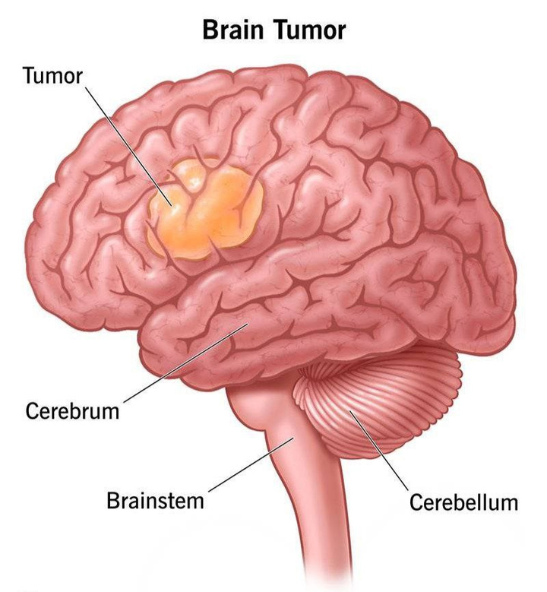
What Is Brain cancer?
Brain cancer occurs when certain brain cells grow uncontrollably, forming lumps (tumors) that can interfere with normal brain function. Understanding the specific type of tumor is crucial for doctors to accurately diagnose the condition and choose the most effective treatment plan
Figher 1 :Brain Tumor

Slide 4



What is gene expression?
Gene expression in brain cancer = the level at which genes are active in brain cells.
Each tumor type exhibits a unique gene expression profile.For instance, a gene may be highly expressed in glioblastoma but low in astrocytoma. These differences form a biological fingerprint that can be exploited for classification

Slide 5


Type Of Tumor
Ependymoma(46)– moderate tumor.
Glioblastoma(34)– aggressive tumor.
Medulloblastoma(22)– fast pediatric tumor.
Pilocytic Astrocytoma(15)– benign tumor.
Normal Brain(13)– healthy tissue.

Slide 6
Why We Need AI ?
Traditional diagnostics like MRI or biopsy can show where a tumor is and its size but cannot identify the specific genes responsible for its behavior
Gene expression data contains information on tens of thousands of genes, making manual analysis difficult.
Advanced computational methods, such as AI and machine learning, are needed to analyze these complex datasets and accurately classify tumor subtypes based on their molecular profiles.

Slide 7
Machine Learning Role
• Training: The model learns patterns of gene activity that distinguish one cancer type from another.
• Testing: Given a new gene expression profile, the model predicts the correct cancer subtype.
• Methods: XG Boost, Random Forests, SVM, Neural Networks,

Slide 8

About dataset
We use the GSE50161 dataset from the CuMiDa database, which has well-prepared gene expression data for brain tumors. It includes five groups making it a realistic classification task beyond simple “cancer vs. non-cancer.”
Why CuMiDa
1 High Quality – Data is pre-processed with normalization and quality checks, so AI learns real biological signals.
2 Challenging – Around 54,676 gene features with only ~130 samples create a “many features, few samples” problem.
3 Benchmarking – Widely used for AI in cancer research, allowing comparison with standard results.

Slide 9

Preprocessing

Slide 10

Feature Selection
Checking for Missing Data
Data
Splitting
Handling Class Imbalance

Slide 11

Checking for Missing Data
We checked for any missing values to ensure the dataset is clean, as missing data can reduce the model’s performance.
• If no missing values are found → we can proceed.
•If missing values are detected → we handle them appropriately before modeling.

Slide 12
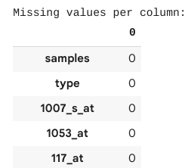
Checking for Missing Data
Missing Values Check Result

Slide 13
Feature Selection
Since the dataset contains many genes, we used methods like PCA and SelectKBest to identify the most important features for classification.
This helps reduce data complexity and improves model accuracy.

Slide 14

Feature Selection
Selected Top Features

Slide 15
Data Splitting
We split the dataset into training and testing sets to evaluate the model’s performance on unseen data.
• The training set is used to train the model.
•The testing set is used to assess how well the model generalizes.

Slide 16
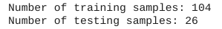
Data Splitting
Train-Test Split

Slide 17
Handling Class Imbalance
We applied SMOTE to balance the class distribution in the training set by generating synthetic samples for the minority class, ensuring fair model learning.

Slide 18
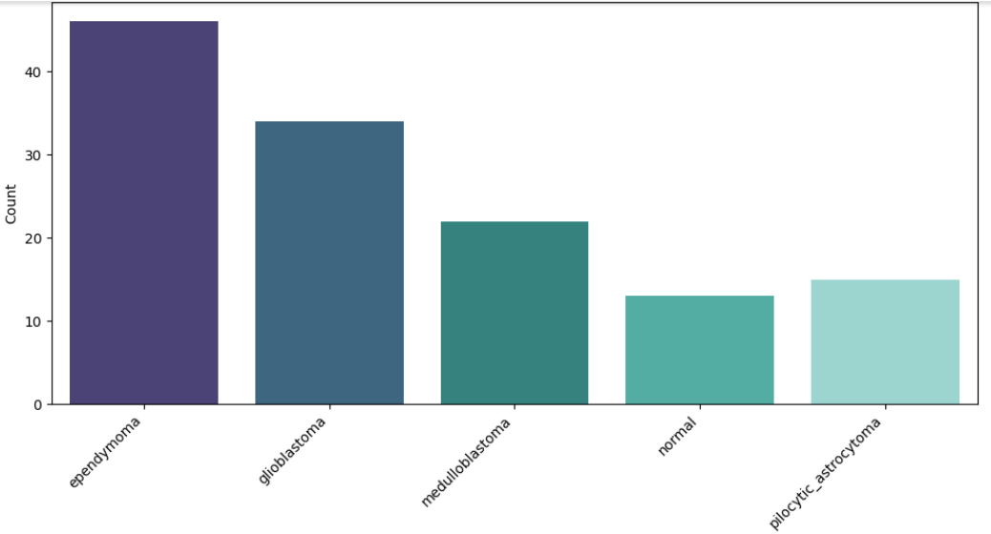
Handling Class Imbalance
Class Distribution Before Balancing

Slide 19
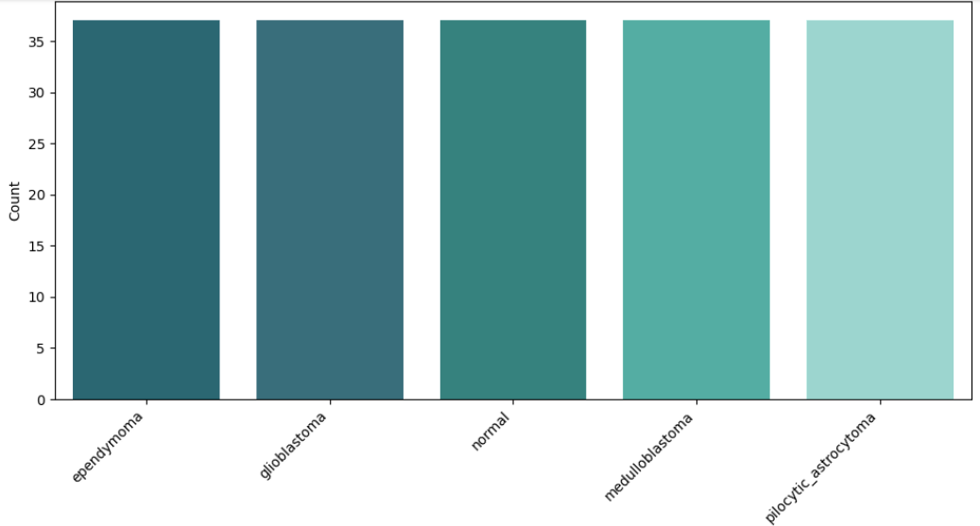
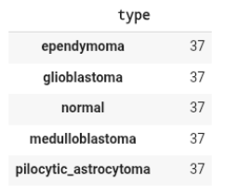
Handling Class Imbalance
Class Distribution After Balancing (SMOTEENN)

Slide 20
Model Design and Training

Slide 21
OUR CHOSEN MODELS:
1. RANDOM FOREST
2. XGBOOST
(EXTREME GRADIENT BOOSTING)
3. SVM
SUPPORT VECTOR MACHINE

Slide 22





1. Random Forest
Why We Chose It: It's excellent at handling high-dimensional data (like thousands of genes) and is less likely to "memorize" the training data (a problem known as overfitting).

Slide 23




2. XGBoost
(Extreme Gradient Boosting)
Why We Chose It: XGBoost is renowned for its exceptional performance and speed, often winning machine learning competitions. It's a highly efficient and powerful algorithm.

Slide 24




3. Support Vector Machine
Why We Chose It: SVM is very effective in high-dimensional spaces and is particularly powerful when there is a clear margin of separation between the classes.

Slide 25
Conclusion

Slide 26

Primary Achievement:
We successfully designed and implemented a full machine learning pipeline to classify five types of brain tissue from complex gene data.
Comparative Analysis:
By testing four distinct models, we identified the Support Vector Machine (SVM) as the most accurate classifier at 92.31%.
Technical Success:
We effectively navigated key bioinformatics challenges, including the "curse of dimensionality" and significant class imbalance, to build a robust model.
Clinical Impact:
Our project demonstrates how machine learning can transform complex genomic data into powerful, actionable insights for cancer diagnosis.

Slide 27
Model Prediction Interface (GUI)

Slide 28
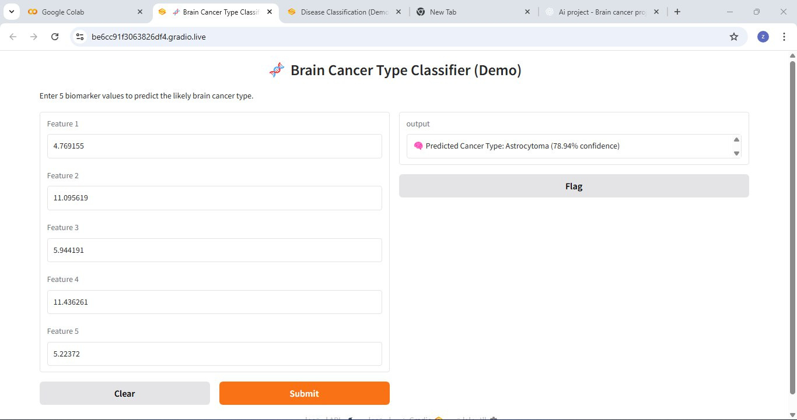

Slide 29
Behind the Scenes

Slide 30
XGBoost
XGBoost

Slide 31
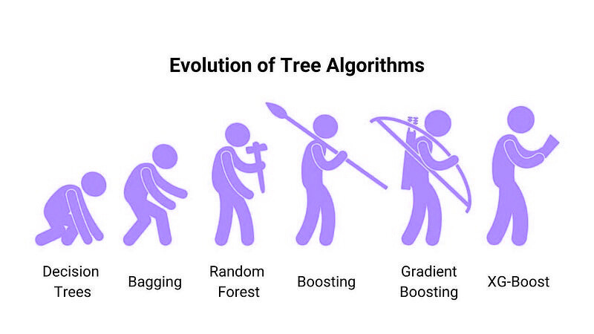
XGBoost
XGBoost stands for Extreme Gradient Boosting, an optimized implementation of the Gradient Boosted Decision Trees (GBDT) algorithm.
It is one of the most powerful and popular machine learning models for structured or tabular data, known for its high predictive performance and speed.

Slide 32
How It Works
Train first tree → makes initial predictions.
Calculate errors → difference between predictions and actual values.
Train next tree → focuses on correcting previous errors.
Repeat → add more trees to fix remaining mistakes.
Combine predictions → sum all trees outputs for final result.
It’s basically “each new tree learns from previous mistakes.”

Slide 33
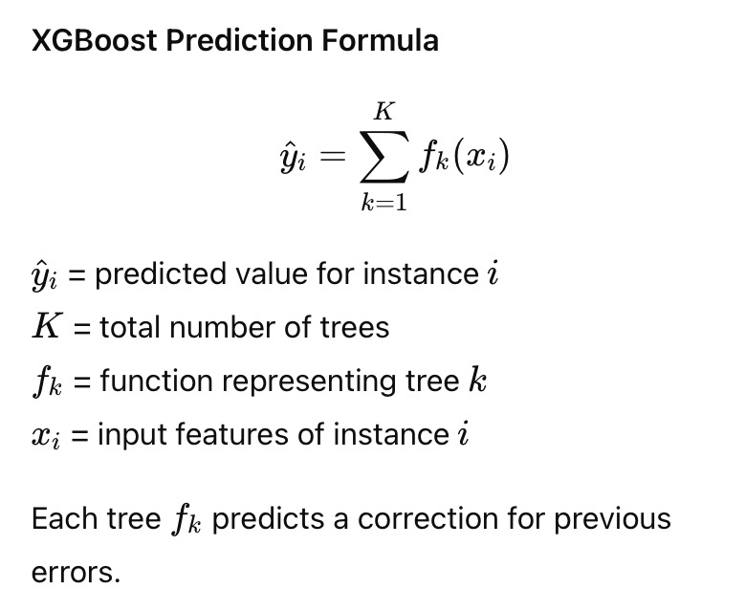
Mathematical Formula

Slide 34
Why It’s “Extreme”
XGBoost improves boosting by:
Regularization: avoids overfitting.
Learning rate: controls tree impact.
Row/column sampling: adds randomness.
Parallel training: faster computation.
Missing values handling: auto-fills optimally.
Tree pruning: removes useless branches.
Result: fast, accurate, reliable for complex data.

Slide 35
XGBoost Key Hyperparameters
n-estimators = 500
This means the model builds 500 trees.
We chose this number so the model has enough trees to learn complex gene patterns without overfitting
• learning_rate = 0.05
This controls how much each new tree contributes to the model.
lower → slower but stable learning
• max_depth = 5
This limits how deep each tree can grow.
• subsample = 0.8
Each tree is trained on 80% of the data randomly selected.
This adds randomness and helps prevent overfitting.

Slide 36
XGBoost Key Hyperparameters
• colsample_bytree = 0.7
Each tree uses 70% of the features (genes).
This reduces correlation between trees
• reg_alpha = 0.1 and reg_lambda = 1.0
These are L1 and L2 regularization terms.
They add a small penalty when the model becomes too complex — helping it generalize better instead of memorizing the data
eval_metric='mlogloss' to measure multi-class prediction accuracy
random_state=42 to ensure consistent, reproducible results.
These hyperparameters control model complexity, learning speed, and generalization.

Slide 37
EVALUATION METRICS
Evaluate accuracy, precision, recall, F1-score on test data.
Accuracy 0.885 – How often the model predicts the correct cancer type.
Precision 0.915 – Of all predicted cases for a type, how many were correct.
Recall 0.885 – Of all actual cases of a type, how many were detected.
F1-score 0.890 – Combines precision and recall to show overall balance.

Slide 38
Model Interpretation
XGBoost allows us to understand which features drive predictions .is a crucial in biomedical research.
Feature Importance:
Which PCA components (or genes) are most predictive.
SHAP Values:
Quantify how each feature affects a specific prediction.

Slide 39
Limitations
Requires careful hyperparameter tuning.
Can overfit if too deep or too many trees.
Less interpretable than simpler models (though SHAP helps).
Computationally heavy for extremely large or high-resolution data.

Slide 40
XGBoost
SVM

Slide 41
Support Vector Machine (SVM)
is a machine learning algorithm used for classification and prediction. It works by finding the best line or boundary that separates data into different classes with the maximum margin between them.
When the data is not linearly separable, SVM uses a Kernel function to transform the data into a higher dimension, making it easier to separate.
Common Kernel types:
-Linear Kernel
-Polynomial Kernel
-RBF (Radial Basis Function)
-Sigmoid Kernel
---
هل ترغبين أن أضيف ترجمة عربية بسيطة أسفلها لتكون في الشريحة نفسها؟

Slide 42
أكيد 🌸 إليك شرح طريقة عمل SVM بشكل نقاط بسيطة وواضحة للبرزنتيشن:
How SVM Works:
🔹 SVM takes the data and tries to separate it into classes.
🔹 It finds the best boundary (hyperplane) that divides the data.
🔹 The boundary is chosen so the margin (distance between classes) is as large as possible.
🔹 The points closest to the boundary are called Support Vectors.
🔹 These points help SVM define the best separating line or plane.

Slide 43
أكيد 🌸 إليك شرح طريقة عمل SVM بشكل نقاط بسيطة وواضحة للبرزنتيشن:
Advantages of SVM
🔹 High accuracy in classification.
🔹 Works well with small and complex datasets.
🔹 Effective in clearly separating different classes.
🔹 Can use different kernel types to handle non-linear data.
Disadvantages of SVM
🔹 Takes a long time to train on large datasets.
🔹 Difficult to interpret compared to other algorithms.
🔹 Sensitive to the choice of kernel parameters.
🔹 Does not perform well with noisy or overlapping data.

Slide 44
Random Forest

Slide 45


THYNK UNLIMITED.
Random Forest
is a supervised machine learning algorithm used for classification and regression tasks.
It works by creating a “forest” of many decision trees, where each tree makes its own prediction — and the final result is based on the majority vote (for classification) or average (for regression) of all trees.

Slide 46

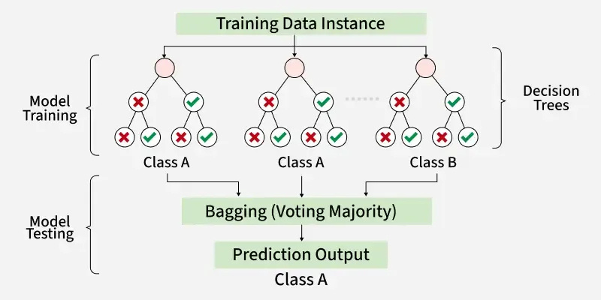
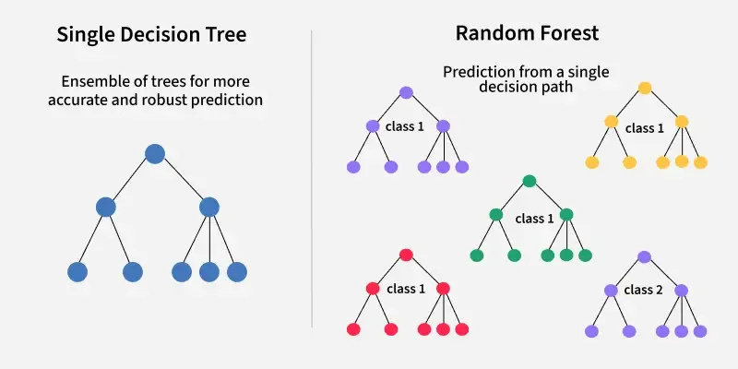
How It Works ?
1. Training the Model
The Random Forest algorithm creates multiple decision trees using random subsets of genes and samples.
Each tree captures slightly different patterns, which improves generalization and reduces overfitting.
At each split, a random group of features is tested to find the best threshold separating tumor and normal samples.
2. Making Predictions
When a new gene expression sample is tested, every tree in the forest votes for a class.
The final prediction (tumor or normal) is determined by the majority vote across all trees.
3. Model Evaluation
We evaluated the model using a train-test split to calculate accuracy, precision, recall, and F1-score.
These metrics show how effectively the model distinguishes cancerous from healthy samples.
4. Biological Insight
Random Forest also provides feature importance values, showing which genes most influence predictions.
This helps identify key biomarkers that may play a role in brain cancer development.

Slide 47
Advantages & Limitations:
Advantages :
Random Forest provides very accurate predictions even with large datasets.
Random Forest can handle missing data well without compromising with accuracy.
When we combine multiple decision trees it reduces the risk of overfitting of the model.
Limitations :
It can be computationally expensive especially with a large number of trees.
It’s harder to interpret the model compared to simpler models like decision trees.

Slide 48
XGBoost
Performance Comparison

Slide 49
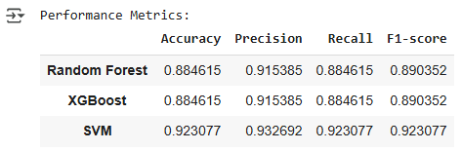
As the table shows, the Support Vector Machine (SVM) proved to be the top model, achieving a 92.31% accuracy. While the other models also performed well, confirming the effectiveness of our feature selection, the SVM's ability to define clear boundaries between the tissue types made it the most successful for this dataset.

Slide 50
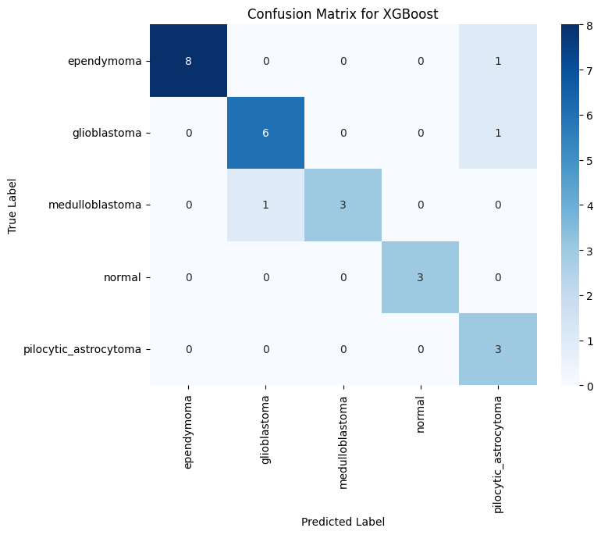
1. XGBoost
Key Strengths: The model shows high accuracy and correctly identified:
8 out of 9 ependymoma samples.
6 out of 7 glioblastoma samples.
100% of normal and pilocytic_astrocytoma samples.
Points of Confusion: The model's few errors involved misclassifying some tumors as pilocytic_astrocytoma and confusing one medulloblastoma for a glioblastoma, which may indicate similar genetic signatures.
Overall Conclusion: The XGBoost model is a highly robust classifier, demonstrating strong predictive power with only minor confusion between specific, closely related tumor types.

Slide 51
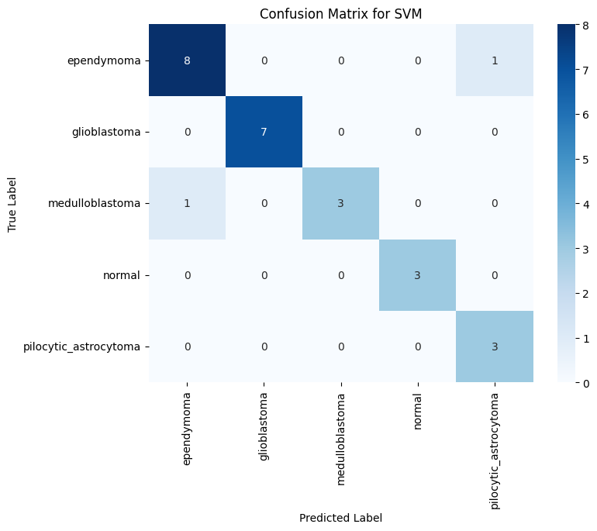
2. SVM
Key Strengths: The SVM model shows outstanding performance, correctly identifying:
100% of glioblastoma, normal, and pilocytic_astrocytoma samples.
8 out of 9 ependymoma samples.
Points of Confusion: The model made only two minor errors: misclassifying one ependymoma as pilocytic_astrocytoma and one medulloblastoma as ependymoma.
Overall Conclusion: The SVM is the top-performing classifier in this analysis, demonstrating exceptional accuracy and the fewest errors, making it the most reliable model for this task.

Slide 52

3. Random Forest
Key Strengths: The model shows excellent performance, correctly identifying:
8 out of 9 ependymoma samples.
6 out of 7 glioblastoma samples.
100% of normal and pilocytic_astrocytoma samples.
Points of Confusion: The few errors were minor, mainly confusing one medulloblastoma for a glioblastoma, suggesting high similarity in their genetic profiles.
Overall Conclusion: The Random Forest is a highly effective classifier for this task, showing strong accuracy with only minimal confusion between specific tumor types.

Slide 53
Thank You
-

